Slide 1
XV6 Installation and Execution

Slide 2
Hurdles faced during Installation of XV6 and QEMU

Slide 3
Commands Used:
sudo apt-get update
Function:
To download and install the latest updates for Ubuntu
(sudo - super user do, apt-get - package to search online and install the libraries for the specified tools/utilities)

Slide 4
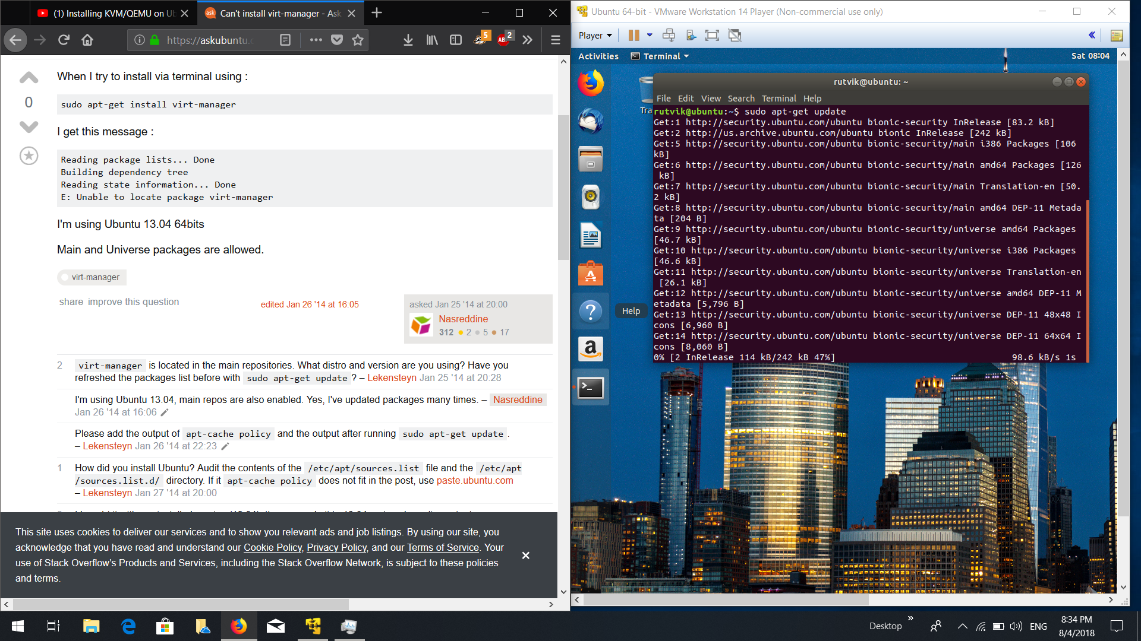

Slide 5
Commands Used:
sudo apt-get install qemu-system
Function:
To install all the files for QEMU emulator upon which XV6 will be run

Slide 6
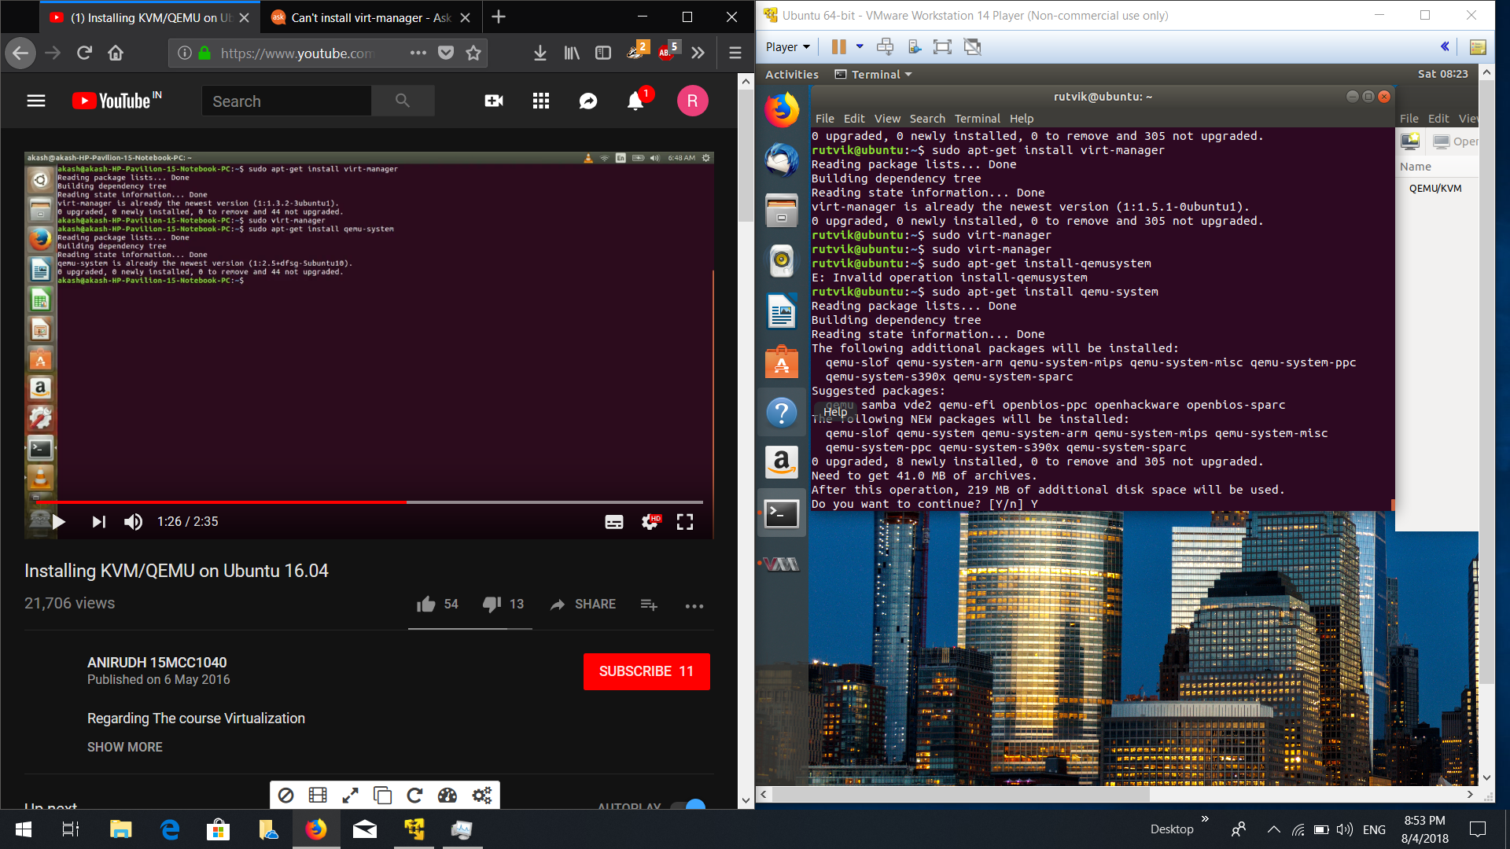

Slide 7
Commands Used:
sudo apt install git
Function:
git function allows users to access git repositories on GitHub. Here it is used to clone the one source git repository of xv6 by MIT and copy them onto the system local storage.

Slide 8
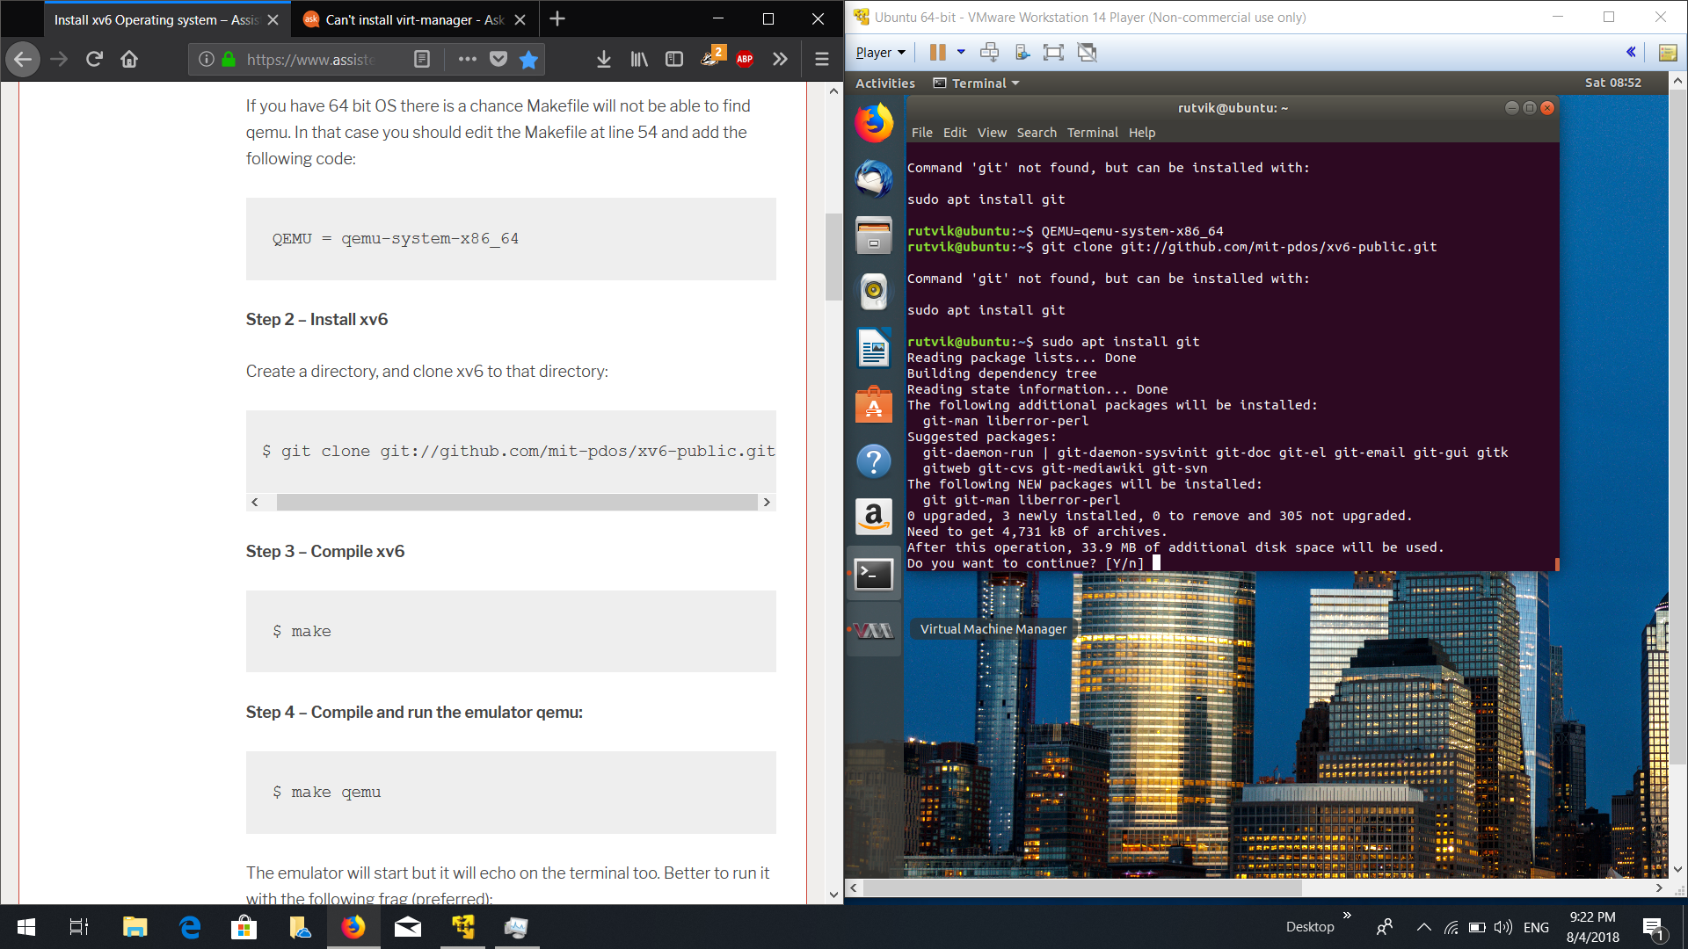

Slide 9
Commands Used:
git clone git://github.com/mit-pdos/xv6-public.git
Function:
To clone the GitHub repository onto the local storage of the system from the specified URL.

Slide 10
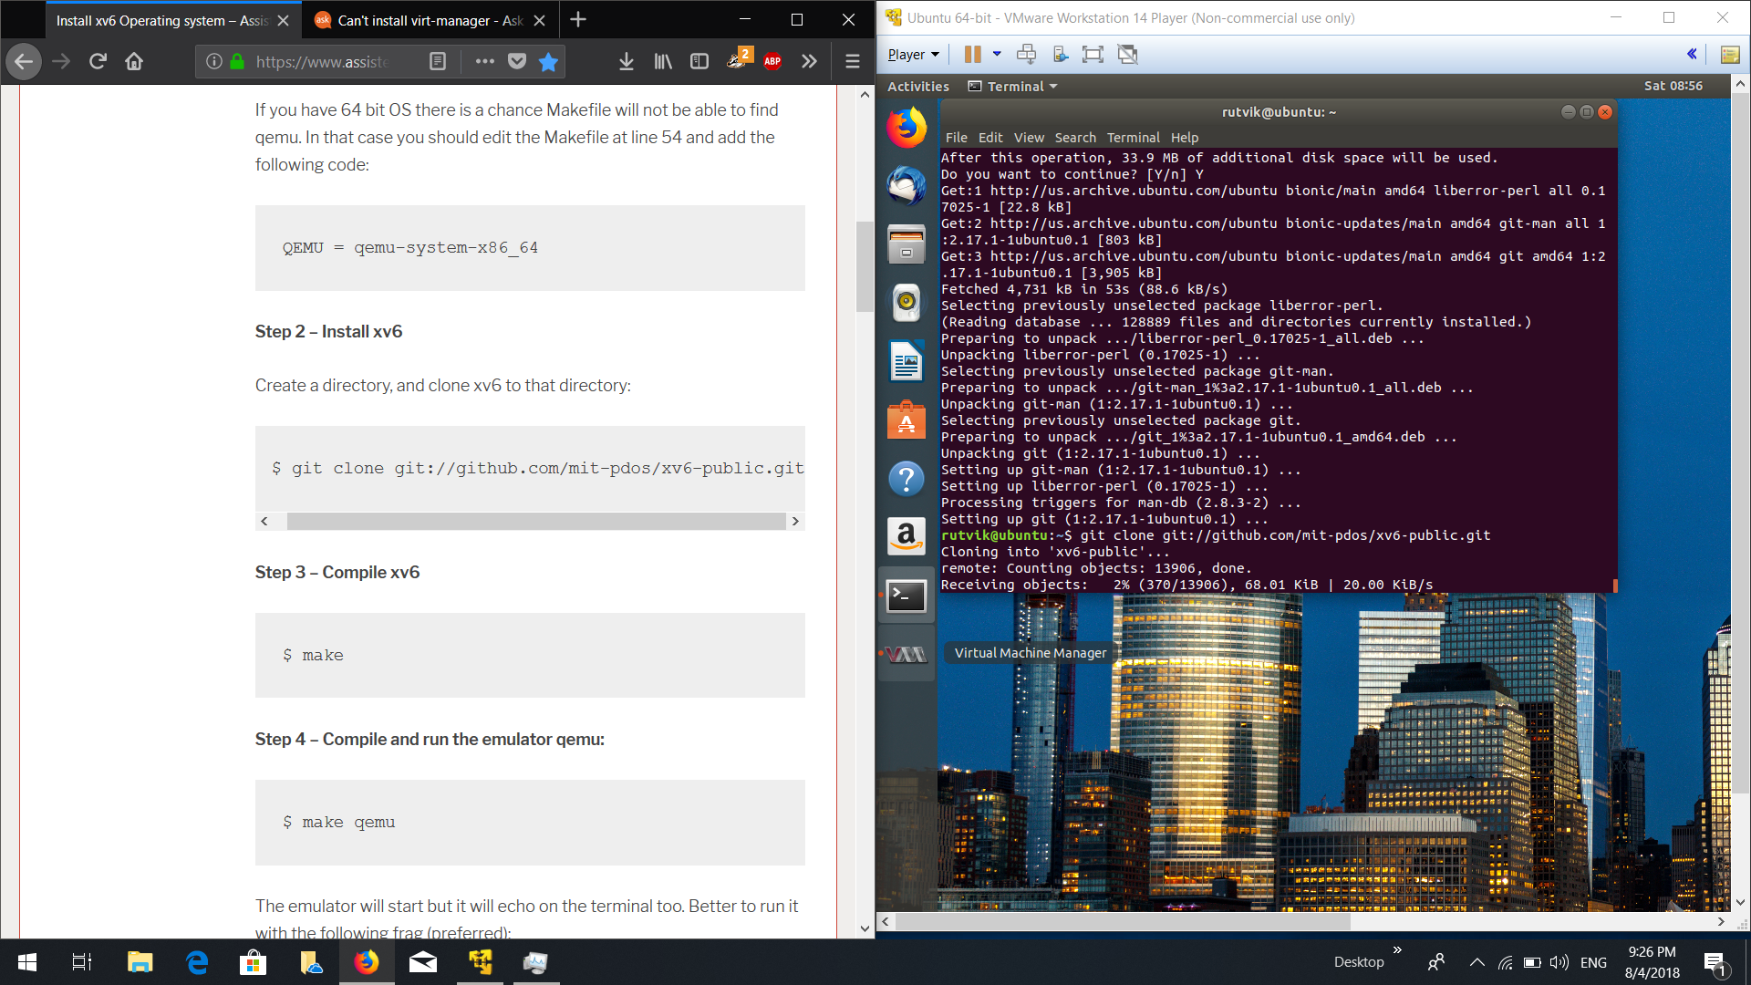

Slide 11
Commands Used:
QEMU=qemu-system-x86_64
Function:
To allow make function to run on qemu in the 64 bit based Operating Systems this command has to be executed.

Slide 12
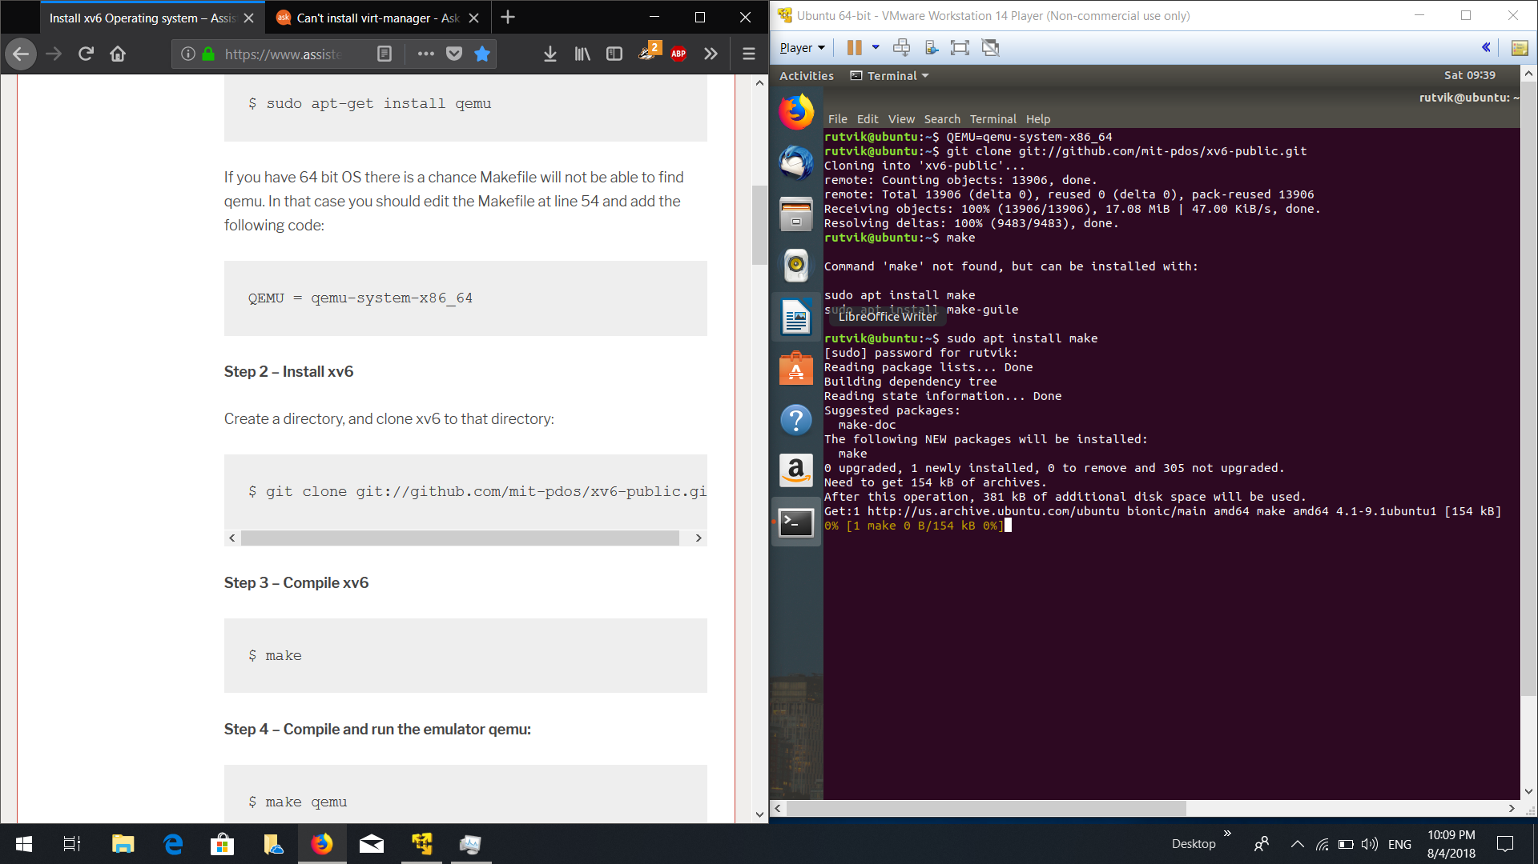

Slide 13
Commands Used:
sudo apt install make
Function:
To download and install the libraries necessary for the make function call

Slide 15
Commands Used:
cd xv6-public
make
make qemu-nox
Function:
cd xv6-public changes directory to xv6-public where make can be executed
make is a utility for building and maintaining groups of programs (and other types of files) from source code
make qemu builds the xv6 files on top of qemu emulator from the xv6-public directory and adding nox doesn’t allow the program to open a separate qemu console window

Slide 16
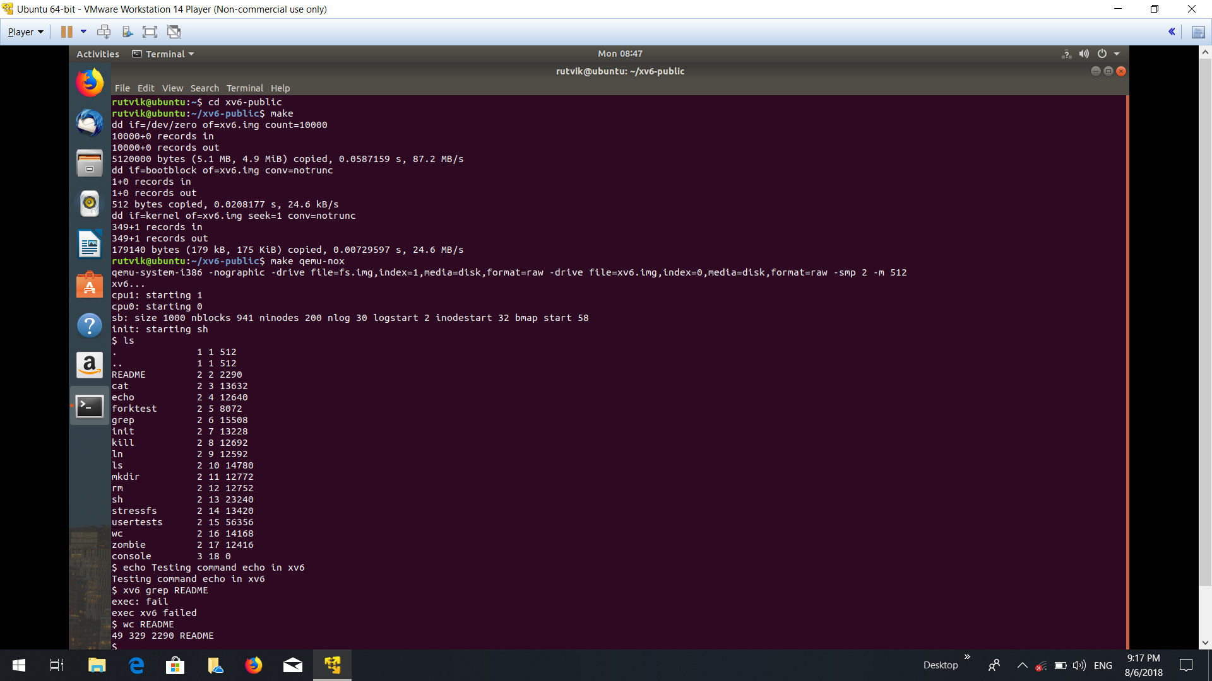

Slide 17
Running XV6 in the Ubuntu terminal

Slide 18
Commands Used:
ls
echo <Statement>
wc README
Function:
List all the directories in the present working directory
echo outputs the statement entered along with echo command
wc outputs the line count, word count and character count of the README file present in xv6

Slide 20
Commands Used:
mkdir <folder_name>
usertests
Function:
mkdir makes a new folder/directory in the present working directory of given name
usertests runs and tests various processes belonging to both the kernel and the user and saves the report in the xv6-public directory

Slide 21
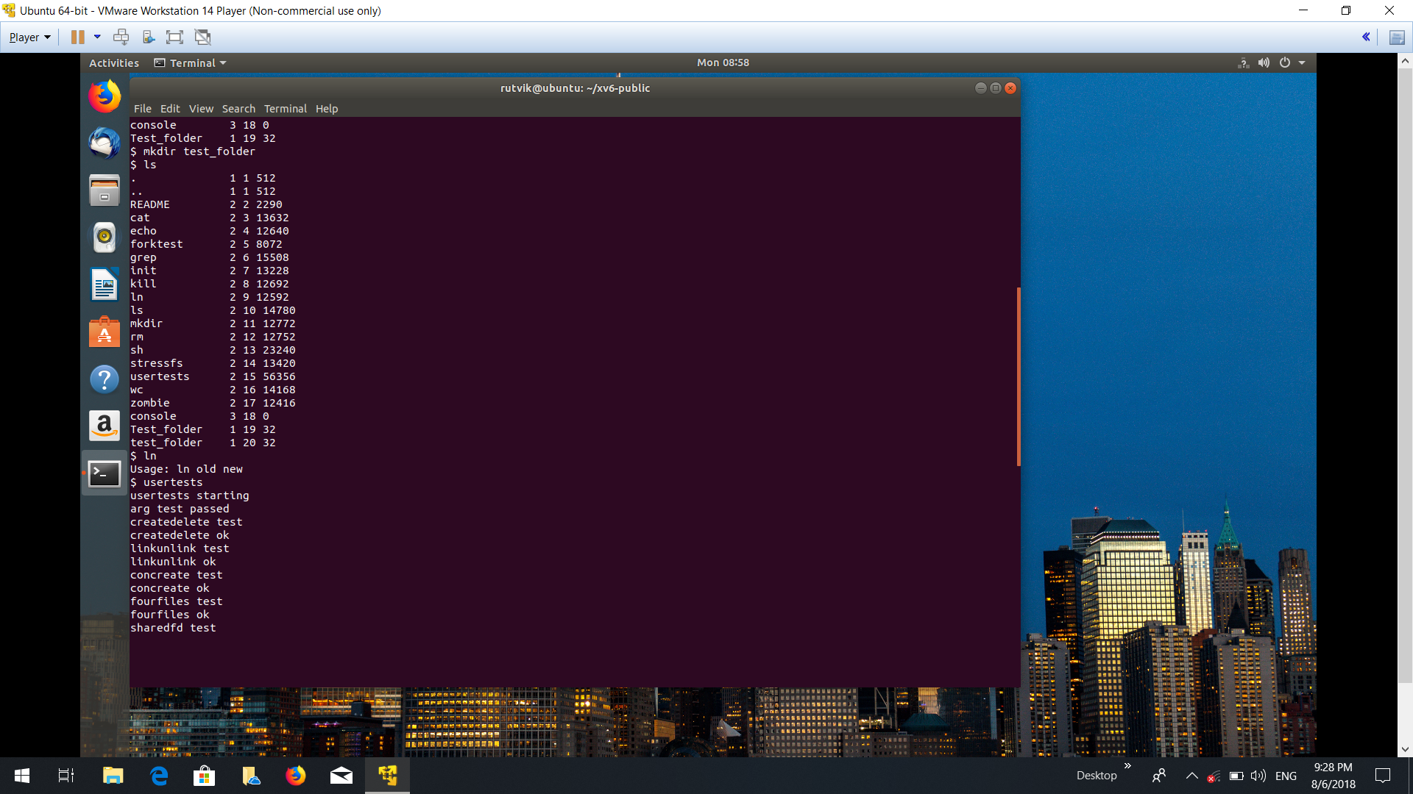

Slide 22
Commands Used:
cat README
Function:
cat function reads the file sequentially (here: README ) and outputs the contents of the file

